Slide 1
Incarcerated Veterans & Dependent Considerations
Presented by: Evan Walton, SDDVA Training Coordinator

Slide 2
Course Topics
Incarcerated or “Justice Involved” Veterans: Definition and Regulation
Exceptions
VA actions while incarcerated
Regaining benefits
Apportionment for Spouse or Dependents
Appeal Considerations
Q&A

Slide 3
Official VA Definition
VI.iii.A.1.a.
refers to the confinement of an individual in a penal institution, even though the individual may be allowed outside the institution temporarily on furlough or for medical treatment, and
includes confinement at any of the following, as long as confinement is pursuant to a criminal sentence:
medical facility or mental institution, or
other locations, such as work camps, forestry camps, or boot camps.

Slide 4
Conviction Date
The date a court formally finds a defendant guilty of an offense
This is the date used by VA to determine whether to reduce or terminate VA benefits during incarceration.
Do not confuse this date with the sentencing date or the confinement date.

Slide 5
Code of Federal Regulations
38 CFR 3.666
Requires the discontinuance of a beneficiary’s pension when the beneficiary is incarcerated for more than 60 days following a conviction of a felony or misdemeanor.
Requires the removal of an incarcerated dependent from a beneficiary’s award if the beneficiary receives a pension. There is no such requirement; however, if the beneficiary is a veteran receiving disability compensation or a surviving spouse receiving DIC.
38 CFR 3.665
Requires the reduction of a beneficiary’s disability compensation or Dependency and Indemnity Compensation (DIC) when the beneficiary is incarcerated for more than 60 days following conviction of a felony.

Slide 6
Exceptions
Do not reduce or discontinue benefits for any period during which the Individual in question is:​
Participating in a work release program​
Under community control​
Incarcerated in a foreign penal institution ​​
Do not reduce or discontinue benefits for any period during which the individual in question is residing in a:​
Halfway house​
Residential re-entry center​
Civil commitment center

Slide 7
Benefits During Incarceration
What happens to their compensation when a veteran becomes incarcerated?
Case Example:
Veteran John Smith is receiving VA disability compensation of $1,200 a month and has VA health care. He is also currently utilizing his GI Bill to attend his local community college. John is arrested on 01/10/2026 and convicted of a felony on 04/10/2026 and confined in a state prison.
Notes:
When does the VA STOP paying John? (never a complete zero) When are his benefits reduced? (61st day 06/11/2026)
Does John still have access to VA health care while incarcerated?
Would John still receive GI Bill payments while incarcerated?

Slide 8
Benefits while incarcerated continued
VA can pay certain benefits to veterans who are incarcerated in a federal, state, or local institution, but the amount depends on the type of benefit and the reason
VA disability compensation payments are reduced if a veteran is convicted of a felony and given a prison term for more than 60 days
Q: How much of a veteran’s disability rate are they entitled to while incarcerated?
Notes:
Answer: ON DAY 61, a veteran rated at 20 percent or more will receive a 10 percent disability rate, while a veteran with only a 10 percent rating would receive one-half of 10 percent

Slide 9
SMC’s During Incarceration
If the veteran’s disability evaluation for all service-connected (SC) disabilities is 0 percent, but the veteran is entitled to SMC under 38 U.S.C. 114(K) or a protected rate under 38 CFR 3.959 (statutory SMC Q) then 38 CFR 3.665(d)(2) requires VA to reduce the veteran’s monthly award to one half of the amount of the amount payable for a SC disability evaluated as 10 percent disabling.

Slide 10
How to Calculate Incarceration
When calculating the 61st day of incarceration, start with the first full day of imprisonment following conviction.​​
Do not include in the calculation the number of days the incarcerated individual spent in confinement while awaiting trial, or for examination or treatment, even if the individual is credited for those days as “time served” following conviction.

Slide 11
Regaining Benefits After Incarceration
VA does not require beneficiaries to submit a specific form to report that incarceration has ended.​
May be reported in writing​
By telephone or email​
Or through a VA claims submission service website​
For VA purposes, incarceration ends when an individual:​
Is released from prison​
Is placed under community control (per VAOPGCPREC 59-1991)​
Begins participation in a work release program​
Moves to a halfway house, civil commitment center, or residential re-entry center (as defined by M21-1, Part VI, Subpart iii, 1.A.1.d)

Slide 12
Regaining Benefits Continued
VA cannot resume the payment of benefits that VA reduced or discontinued due to incarceration without confirmation from an official source that incarceration has ended.
Official sources include:
Bureau of Prisons​
County or State Department of Corrections​
County Sheriff or other law enforcement​
Prosecutor’s office​
Parole Board​
Prison Administration

Slide 13
Dependent Apportionment
All or part of the compensation not paid to an incarcerated veteran may be apportioned to the veteran’s spouse, child, or children and dependent parents based on individual need.​
To determine individual need, consideration should be given to such factors as:​
Claimant’s income​
Living expenses​
Amount of compensation available to be apportioned​
The needs and living expenses of other claimants

Slide 14
Dependent Apportionment Continued
An apportionment of an incarcerated veteran’s VA benefits is not granted automatically to the veteran’s dependents
The dependent(s) must file a claim for an apportionment
VA Form 21-0788 is what needs to be completed for the person seeking apportionment​ (Information Regarding Apportionment of Beneficiary’s Award)
Upon receipt of the claim, VA will develop evidence to decide the claim

Slide 15
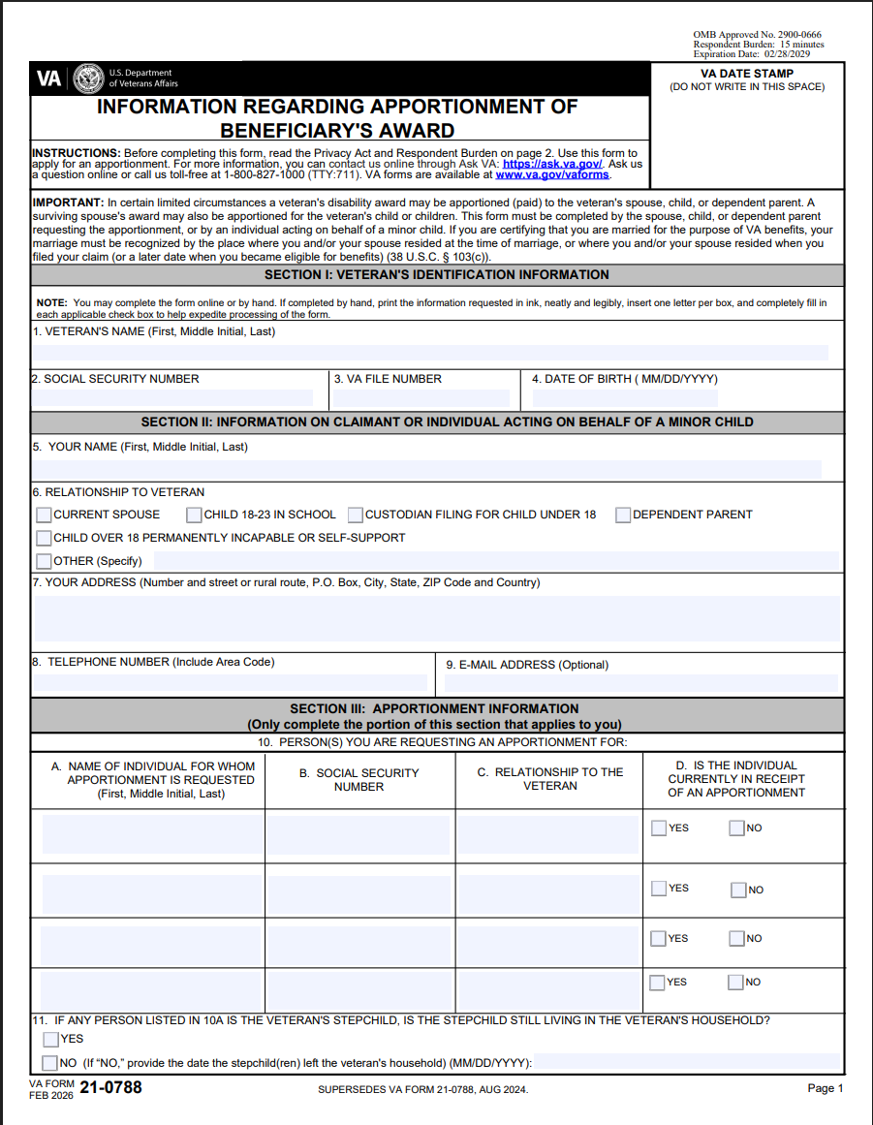
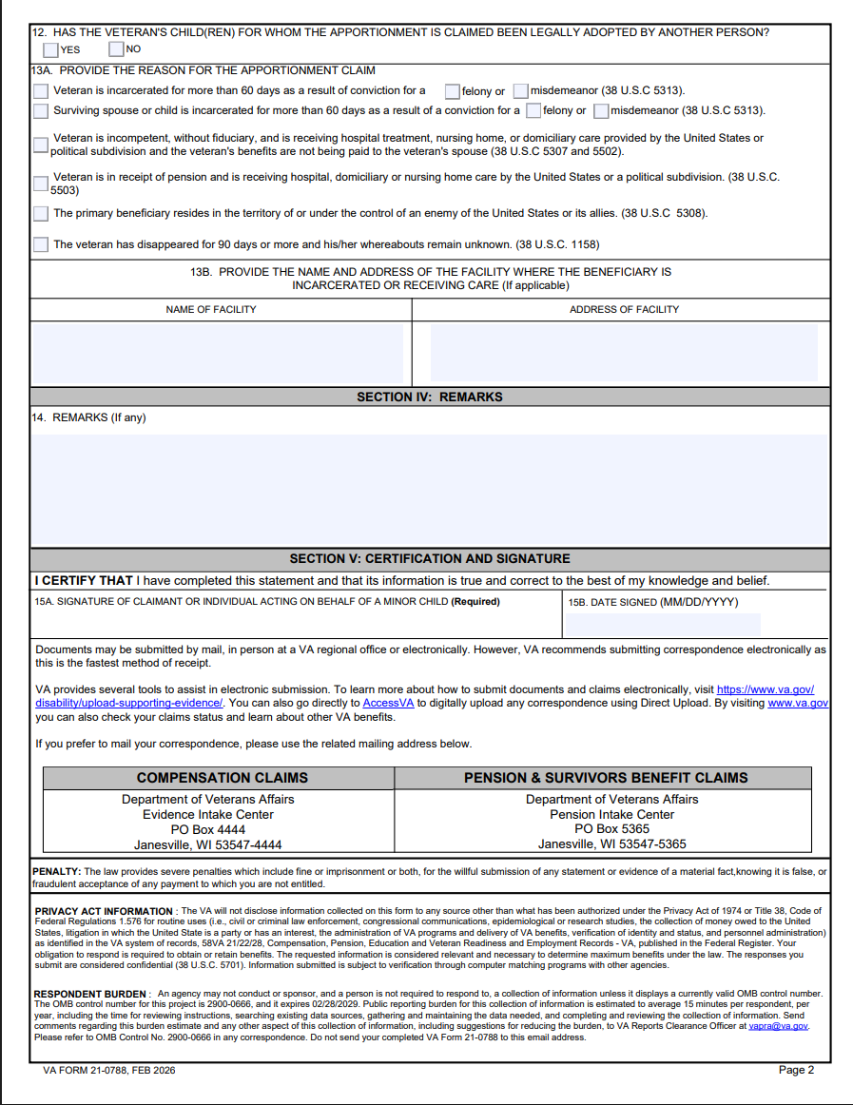
VA Form 21-0788
Notes:
Each participant will have their own copy of this document for review.
Go over each section to ensure nothing is missed.

Slide 16
General Rules for Apportionment
For a claimant to receive an apportionment of a competent primary beneficiary's benefits, the claimant must:​
File a claim and:​
Demonstrate a need for benefits, per the requirements of 38 CFR 3.451 or​
Live apart from the veteran and did not receive a reasonable level of support per 38 CFR 3.450​
If the requirements are met and the primary beneficiary will not suffer undue hardship, VA may authorize an apportionment of the primary beneficiary’s benefits to be paid to the claimant.
Notes:
The VA generally defines "will not suffer undue hardship" for an incarcerated veteran in the context of debt collection (overpayments) or apportionment of benefits, meaning that reducing or recovering the veteran's benefits will not deprive them of the basic necessities of life, such as food, shelter, or necessary medical care
Apportionment Considerations: When apportioning an incarcerated veteran's benefits to dependents, the VA determines "individual need" based on the claimant's income, living expenses, and special needs. If the apportionment results in a situation where the veteran or their dependents cannot afford basic necessities, this may be deemed an undue hardship.
Note: Incarcerated veterans still receive partial benefits to cover personal needs, which the VA considers to avoid automatic hardship for inmates with no dependents.

Slide 17
Scenario
Veteran’s monthly VA disability compensation: $1,500.
Veteran becomes incarcerated for a non-felony offense (or is detained pretrial) and remains eligible for benefits.
Spouse files an apportionment claim with VA, providing marriage certificate, proof of household expenses, and evidence of veteran’s incarceration.
VA determines reasonable apportionment based on the dependent’s needs and the veteran’s ability to manage funds and awards apportionment as follows:
Apportioned to spouse: $1,000/month (to help pay rent, utilities, food, child care).
Remaining paid to veteran (placed in VA account or otherwise held): $500/month.
Result: The spouse receives $1,000/month directly or via VA-directed payment; the veteran continues to receive or have access to the remaining $500.
Notes:
Notes: This is a simplified, illustrative scenario — actual apportionment amounts and eligibility depend on VA rules, type of incarceration, evidence submitted, and individual circumstances.

Slide 18
Denied Apportionment
The veteran’s award isn’t subject to apportionment (the particular benefit type or payment rules don’t permit apportionment).
The dependent does not meet the VA’s legal definition of a dependent (insufficient relationship or ineligibility).
Lack of adequate evidence that the dependent is actually in need of support or that the veteran was providing support (insufficient documentation of dependency, living arrangements, financial need).
No proof the veteran cannot or will not provide for the dependent (incarceration alone doesn’t automatically prove inability to provide).

Slide 19
Denied Apportionment
The benefits are already paid to, or legally controlled by, another person/fiduciary or are subject to a court-ordered assignment that prevents apportionment.
The veteran’s benefits are reduced, suspended, or terminated by law (e.g., certain disqualifying criminal dispositions or other statutory offsets), leaving no funds available to apportion.
The apportionment claim was not filed timely or the dependent failed to cooperate with VA requests for information.
Evidence or findings of fraud, misrepresentation, or conflicting statements that undermine the dependent’s claim.

Slide 20
Appeal Considerations
Incorrect date of incarceration (61st day)​
Overpayment due to no notice to VA of incarceration​
Apportionment denied
All appeal lanes are available to incarcerated or justice-involved beneficiaries​​
Communication with the incarcerated individual will be limited or restricted​
Establishment of 3rd party consent may be beneficial

Slide 21
Questions

